Slide 1



Computer Networks Performance Evaluation

Slide 2
Chapter 1
Introduction
Queueing Networks and Markov Chains
Modeling and Performance Evaluation with Computer Science Applications
Second Edition
Gunter Bolch, Stefan Greiner, Hermann de Meer, Kishor S. Trivedi
Wiley, 2006

Slide 3

Outline
1.1 Motivation
1.2 Methodological Background
1.2.1 Problem Formulation
1.2.2 The Modeling Process
1.2.3 Evaluation
1.2.4 Summary
1.3 Basics of Probability and Statistics
1.3.1 Random Variables
1.3.2 Multiple Random Variables
1.3.3 Transforms
1.3.4 Parameters Estimation
1.3.5 Order Statistics
1.3.6 Distribution of Sums

Slide 4
1.1 Motivation (1)
Information processing system designers need methods for the quantification of system design factors such as performance and reliability.
Modern computer,
communication, and
production line systems
process complex workloads with random service demands.
Probabilistic and statistical methods are commonly employed for the purpose of performance and reliability evaluation.

Slide 5
1.1 Motivation (2)
The purpose of this book is to explore major probabilistic modeling techniques for the performance analysis of information processing systems.
Performance measures that are commonly of interest include :
throughput,
resource utilization,
loss probability,
and delay (or response time).

Slide 6
1.1 Motivation (3)
Performance evaluation techniques
Real systems
Discrete-Event Simulation (DES) Models
Analytical Models
The most direct method for performance evaluation is based on actual measurement of the real system under study.
However, during the design phase, the system is not available for such experiments, and yet performance of a given design needs to be predicted to verify that it meets design requirements and to carry out necessary trade-offs.

Slide 7
1.1 Motivation (4)
Discrete-Event Simulation (DES) :
The most popular models
DES can be applied to almost all problems of interest.
System details to the desired degree can be captured in such simulation models.
Furthermore, many software packages are available that facilitate the construction and execution of DES models.
The principal drawback of DES models, however, is the time taken to run such models for large, realistic systems, particularly when results with high accuracy (i.e., narrow confidence intervals) are desired.

Slide 8
1.1 Motivation (5)
Analytic Models :
a cost-effective alternative to DES models,
able to provide relatively quick answers to “what if” questions
providing more insight into the system being studied
now, capable of solving more complex systems because of :
- recent advances in stochastic models and
numerical solution techniques
- availability of software packages, and
- easy access to workstations with large
computational capabilities

Slide 9
1.1 Motivation (6)
Analytic Models (cont’d):
However, analytic models are often plagued by unrealistic assumptions that need to be made in order to make them tractable.
broadly classified into :
- state-space models
- non-state-space models
Most commonly used state-space models are Markov chains.

Slide 10
1.1 Motivation (7)
Markov chains :
First introduced by A. A. Markov in 1907, Markov chains have been in use in performance analysis since around 1950.
A Markov chain consists of a set of states and a set of labeled transitions between the states.
A state of the Markov chain can model various conditions of interest in the system being studied.
These could be the number of jobs of various types waiting to use each resource, the number of resources of each type that have failed, the number of concurrent tasks of a given job being executed, and so on.

Slide 11
1.1 Motivation (8)
Markov chains (cont’d):
After a sojourn in a state, the Markov chain will make a transition to another state. Such transitions are labeled with either probabilities of transition (in case of discrete-time Markov chains) or rates of transition (in case of continuous-time Markov chains).
Long run (steady-state) dynamics of Markov chains can be studied using a system of linear equations with one equation for each state.

Slide 12
1.1 Motivation (9)
Markov chains (cont’d):
Transient (or time dependent) behavior of a continuous-time Markov chain gives rise to a system of first-order, linear, ordinary differential equations.
Solution of these equations results in state probabilities of the Markov chain from which desired performance measures can be easily obtained.

Slide 13
1.1 Motivation (10)
Markov chains (cont’d):
The number of states in a Markov chain of a complex system can become very large, and, hence, automated generation and efficient numerical solution methods for underlying equations are desired.
A number of concise notations (based on queuing networks and stochastic Petri nets) have evolved, and software packages that automatically generate the underlying state space of the Markov chain are now available.
These packages also carry out efficient solution of steady-state and transient behavior of Markov chains.

Slide 14
1.1 Motivation (11)
Non-state-space Models:
If the Markov chain has nice structure, it is often possible to avoid the generation and solution of the underlying (large) state space.
For a class of queuing networks, known as product-form queuing networks (PFQN), it is possible to derive steady-state performance measures without resorting to the underlying state space.
Other examples of non-state-space models are directed acyclic task precedence graphs [SaTr87] and fault-trees [STP96].
Relatively large PFQN can be solved by means of a small number of simpler equations.

Slide 15
1.1 Motivation (12) *****
Relatively large PFQN can be solved by means of a small number of simpler equations.
However, practical queuing networks can often get so large that approximate methods are needed to solve such PFQN.
Furthermore, many practical queuing networks (so-called non-product-form queuing networks,
NPFQN) do not satisfy restrictions implied by product form.
In such cases, it is often possible to obtain accurate approximations using variations of algorithms used for PFQNs. Other approximation techniques using hierarchical and fixed-point iterative methods are also used.

Slide 16
1.1 Motivation (13) *****
The Flowchart

Slide 17
1.2 Methodological Background (1)
The focus of this book is the application of stochastic and probabilistic methods to obtain conclusions about performance and reliability properties of a wide range of systems.
In general, a system can be regarded as a collection of components which are organized and interact in order to fulfill a common task [IEEESO].

Slide 18
1.2 Methodological Background (2)
Reactive systems :
The real-world systems treated in this book usually contain at least one digital component which controls the operation of other analog or digital components, and the whole system reacts to stimuli triggered by its environment.
As an example, consider a computer communication network in which components like routers, switches, hubs, and communication lines fulfill the common task of transferring data packets between the various computers connected to the network.
If the system of interest is the communication network only, the connected computers can be regarded as its environment which triggers the network by sending and receiving data packets.

Slide 19
1.2 Methodological Background (3)
Nondeterminism :
The behavior of the systems studied in this book can be characterized as nondeterministic since the stimulation by the environment is usually unpredictable.
In case of a communication system like the Internet, the workload depends largely on the number of active users. When exactly a specific user will start to access information on the WWW via a browser is usually not known in advance.
Another source of nondeterminism is the potential failure of one or several system components, which in most cases leads to an altered behavior of the complete system.

Slide 20
1.2 Methodological Background (4)
Modeling advantages :
In contrast to the empirical methods of measurement, i.e., the collection of output data during the observation of an executing system, the deductive methods of model-based performance evaluation have the advantage to be applicable in situations when the system of interest is not yet existing.
Deductive methods can thus be applied during the early design phases of the system development process in order to ensure that the final product meets its performance and reliability requirements.

Slide 21
1.2 Methodological Background (5)
Modeling advantages (cont’d):
They are applicable in the situation in which measurements on an existing system would either be too dangerous or too expensive. New policies, decision rules, or information flows can be explored without disrupting the ongoing operation of the real system.
New hardware architectures, scheduling algorithms, routing protocols, or reconfiguration strategies can be tested without committing resources for their acquisition/implementation.
The behavior of an existing system under a variety of anticipated workloads and environments can be evaluated very cost-effectively in advance.

Slide 22
1.2 Methodological Background (6)
Modeling advantages (cont’d):
It should be noticed that measurement as a supplementary technique can be employed to validate that the conclusions obtained by model-based performance evaluation can be translated into useful statements about the real-world system.

Slide 23
1.2.1 Problem Formulation (1)
Before a meaningful model-based evaluation can commence, one should carefully consider what performance metric is of interest besides the nature of the system.
In general, it is important to consider the crucial aspects of the application domain with respect to the metrics to be evaluated before starting with the formalization process.
As an illustrative example, consider the power outage problem of computer systems.
For a given hardware configuration, there is no ideal way to represent it without taking into consideration the software applications which run on the hardware and which of course have to be reflected in the model.

Slide 24
1.2.1 Problem Formulation (2)
In a real-time context, such as flight control, even the shortest power failure might have catastrophic implications for the system being controlled. Therefore, an appropriate reliability model of the flight control computer system has to be very sensitive to such a (hopefully) rare event of short duration.
In contrast, the total number of jobs processed or the work accomplished by the computer hardware during the duration of a flight is probably a less important performance measure for such a safety-critical system.

Slide 25
1.2.1 Problem Formulation (3)
If the same hardware configuration is used in a transaction processing system, however, short outages are less significant for the proper system operation but the throughput is of predominant importance.
As a consequence thereof, it is not useful to represent effects of short interruptions in the model, since they are of less importance in this application context.

Slide 26
1.2.1 Problem Formulation (4)
Another important aspect to consider at the beginning of a model-based evaluation is how a reactive real-world system - as the core object of the study - is triggered by its environment.
The stimulation of the system by its environment has to be captured in such a way during formalization so it reflects the conditions given in the real world as accurately as possible.
In the context of stochastic modeling, the expression of the environment’s influence on the system in the model is usually referred to as workload modeling.
Examples of the arriving workloads are :
the parts entering a production line
the arriving data packets in a communication system

Slide 27
1.2.1 Problem Formulation (5)
The following categories of system properties which are within the scope of the methods presented in this book can be identified:
Performance Properties,
Reliability and Availability,
Dependability and Performability.

Slide 28
1.2.1 Problem Formulation (6)
Performance Properties :
In [IEEE9O], software engineering performance is defined as:
Definition 1.1 Performance : The degree to which a system or component accomplishes its designated functions within given constraints, such as speed, accuracy, or memory usage.
Typical properties :
- the mean throughput of served customers
- the mean waiting
- response time and
- the utilization of the various system resources

Slide 29
1.2.1 Problem Formulation (7)
Reliability and Availability :
Requirements of these types can be evaluated quantitatively if the system description contains information about the failure and repair behavior of the system components.
In some cases it is also necessary to specify the conditions under which a new user cannot get access to the service offered by the operational system.
The information about the failure behavior of system components is usually based on heuristics which are reflected in the parameters of probability distributions.

Slide 30
1.2.1 Problem Formulation (8)
Reliability and Availability (cont’d):
In [IEEE9O], software reliability is defined as:
Definition 1.2 Reliability: The probability that the software will not cause the failure of the system for a specified time under specified conditions.
In [IEEE9O], Availability is defined as:
Definition 1.3 Availability: The ability of a system to perform its required function at a stated instant or over a stated period of time. It is usually expressed as the availability ratio, i.e., the proportion of time that the service is actually available for use by the Customers within the agreed service hours.

Slide 31
1.2.1 Problem Formulation (9)
Reliability and Availability (cont’d):
System reliability is a measure for the continuity of correct service, whereas availability measures for a system refer to its readiness for correct service, as
Reliability and availability are related yet distinct system properties:
A system which - during a mission time of 100 days - fails on average every two minutes but becomes operational again after a few milliseconds is not very reliable but nevertheless highly available.

Slide 32
1.2.1 Problem Formulation (10)
Dependability :
The following definition for dependability is taken from [ALRL04] :
Definition 1.4 Dependability: The dependability of a computer system is the ability to deliver a service that can justifiably be trusted.
The service delivered by a system is its behavior as it is perceived by its user(s);
A user is another system (physical, human) that interacts with the former at the service interface.

Slide 33
1.2.1 Problem Formulation (11)
Dependability (cont’d) :
This is a rather general definition which comprises the five attributes :
- availability,
- reliability,
- maintainability - the systems ability to undergo
modifications or repairs,
- integrity - the absence of improper system
alterations and
- safety as a measure for the continuous delivery
of service free from occurrences of
catastrophic failures.

Slide 34
1.2.1 Problem Formulation (12)
Performability :
Coined by J.F.MEYER [Meye78] as a measure to assess a system’s ability to perform when performance degrades as a consequence of faults:
Definition 1.5 Performability: The probability that the system reaches an accomplishment level y over a utilization interval (0, t ) .
That is, the probability that the system does a certain amount of useful work over a mission time t.
Informally, the performability refers to performance in the presence of failures/repair/recovery of components and the system.

Slide 35
1.2.1 Problem Formulation (13)
Performability (cont’d):
It is of special interest for gracefully degrading systems [Beau77].
In Section 2.2, a framework based on Markov reward models (MRMs) is presented which provides recipes for a selection of the right model type and the definition of an appropriate performance measure.

Slide 36
1.2.2 The Modeling Process (1)
The first step of a model-based performance evaluation consists of the formalization process, during which the modeler generates a formal description of the real-world system.
Figure 1.2 illustrates the basic idea: Starting from an informal system description, e.g. in natural language, including :
- structural information,
- functional information,
- as well as the desired performance and
reliability requirements,
the modeler creates a formal model of the real-world system using a specific conceptualization.

Slide 37
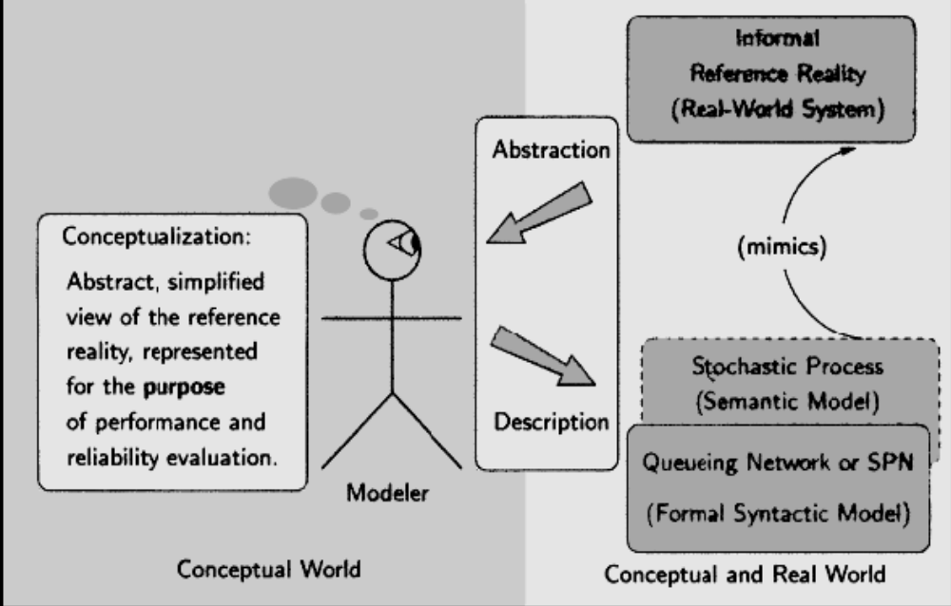
1.2.2 The Modeling Process (2)
Fig. 1.2 Formalization of a real-world system.

Slide 38
1.2.2 The Modeling Process (3)
A conceptualization is an abstract, simplified view of the reference reality which is represented for some purpose.
Two kinds of conceptualizations for the purpose of performance evaluation are presented in detail in this book :
Queuing Networks
Markov Chains

Slide 39
1.2.2 The Modeling Process (4)
If the system is to be represented as a queuing network, the modeler applies a “routed job flow” modeling paradigm in which the real-world system is conceptualized as a set of service stations which are connected by edges through which independent entities “flow” through the network and sojourn in the queues and servers of the service stations (see Chapter 7).
In an alternative Markov chain conceptualization, a “state-transition” modeling paradigm is applied in which the possible trajectories through the system’s global state space are represented as a graph whose directed arcs represent the transitions between subsequent system states (see Chapter 2).

Slide 40
1.2.2 The Modeling Process (5)
The main difference between the two conceptualizations is that the queuing network formalism is oriented more towards the structure of the real-world system, whereas in the Markov chain formalization, the emphasis is put on the description of the system behavior on the underlying state-space level.

Slide 41
1.2.2 The Modeling Process (6)
During the formalization process the following abstractions with respect to the real-world system are applied:
In both conceptualizations the behavior of the real-world system is regarded to evolve in a discrete-event fashion, even if the real-world system contains components which exhibit continuous behavior, such as the movements of a conveyor belt of a production line.

Slide 42
1.2.2 The Modeling Process (7)
The application of the queuing network formalism abstracts away from all synchronization mechanisms which may be present in the real-world system. If the representation of these synchronization mechanisms is crucial in order to obtain useful results from the evaluation, the modeler can resort to variants of stochastic Petri nets as an alternative description technique (see Section 2.3 and Section 2.3.6) in which almost arbitrary synchronization patterns can be captured.

Slide 43
1.2.2 The Modeling Process (8)
The core abstractions applied during the formalization process are
- the association of system activity durations
with random variables, and
- the inclusion of branching probabilities to
represent alternative system evolutions.
Both abstractions resolve the nondeterminisrn inherent in the real-world system and turn the formal queuing network or Markov chain prototype into an “executable” specification [Wing0l].

Slide 44
1.2.2 The Modeling Process (9)
Depending on which kind of random variables are used to represent the durations of the system activities either
- a discrete-time interpretation using a DTMC,
or
- a continuous-time interpretation of the
system behavior based on a CTMC is achieved.
For systems with asynchronously evolving components the continuous-time interpretation is more appropriate since changes of the global system state may occur at any moment in continuous time.
Systems with components that evolve in a lock-step fashion triggered by a global clock are usually interpreted in discrete-time.

Slide 45
1.2.3 Evaluation (1)
The second step in the model-based system evaluation is the deduction of performance measures by the application of appropriate solution methods.
Depending on the conceptualization chosen during the formalization process, the following solution methods are available:
Analytical Solutions
Simulation Solutions
Hybrid solutions
Largeness Tolerance
Largeness Avoidance

Slide 46
1.2.3 Evaluation (2)
Analytical Solutions :
The core principle of the analytic solution methods is to represent the formal system description either :
- as a single equation from which the interesting
measures can be obtained as closed-form
solutions, or
- as a set of system equations from which exact
or approximate measures can be calculated by
appropriate algorithms from numerical
mathematics.

Slide 47
1.2.3 Evaluation (3)
Closed-form solutions :
are available
- if the system can be described as a simple
queuing system (see Chapter 6), or
- for simple product-form queuing networks
(PFQN) [Chhla83] (see Section 7.3), or
- for structured small CTMCs.
Also from certain types of Markov chains with regular structure (see Section 3. 1), closed-form representations like the well-known Erlang-B and Erlang-C formulae [Erlal7] can be derived.
The measures can either be computed by ad-hoc programming or with the help of computer algebra packages such as Mathematica [Mat05].

Slide 48
1.2.3 Evaluation (4)
Closed-form solutions (cont’d):
A big advantage of the closed-form solutions is their moderate computational complexity which enables a fast calculation of performance measures even for larger system descriptions.

Slide 49
1.2.3 Evaluation (5)
Numerical solutions :
Many types of equations which can be derived from a formal system description do not possess a closed-form solution, e.g., in the case of complex systems of integro-differential equations.
In these cases, approximate solutions can be obtained by the application of algorithms from numerical mathematics, many of which are implemented in computer algebra packages [Mat051 or are integrated in performance analysis tools such as SHARPE [HSZTOO], SPNP [HTTOO], or TimeNET [ZFGHOO] (see Chapter 12).

Slide 50
1.2.3 Evaluation (6)
Numerical solutions (cont’d):
The formal system descriptions can be either given as a queuing network, stochastic Petri net or another high-level modeling formalism, from which a state-space representation is generated manually, or by the application of state-space generation algorithms.
In comparison to closed-form solution approaches, numerical solution methods usually have a higher computational complexity.

Slide 51
1.2.3 Evaluation (7)
Simulation Solutions :
For many types of models no analytic solution method is feasible, because either
- a theory for the derivation of proper system
equations is not known, or
- the computational complexity of an applicable
numerical solution algorithm is too high.
In this situation, solutions can be obtained by the application of discrete-event simulation (DES), which is described in detail in Chapter 11.
Instead of solving system equations which have been derived from the formal model, the DES algorithm “executes” the model and collects the information about the observed behavior for the subsequent derivation of performance measures.

Slide 52
1.2.3 Evaluation (8)
Simulation Solutions (cont’d):
In order to increase the quality of the results, the simulation outputs collected during multiple “executions” of the model are collected and from which the interesting measures are calculated by statistical methods.
All the formalizations presented in this book, i.e., queuing networks, stochastic Petri nets, or Markov chains can serve as input for a DES, which is the most flexible and generally applicable solution method.
Since the underlying state space does not have to be generated, simulation is not affected by the state-space explosion problem. Thus, simulation can also be employed for the analysis of complex models for which the numerical approaches would fail because of an exuberant number of system states.

Slide 53
1.2.3 Evaluation (9)
Hybrid solutions :
There exists a number of approaches in which different modeling formalisms and solution methods are combined in order to exploit their complementing strengths.
Examples of hybrid solution methods are mixed simulation and analytical/numerical approaches, or the combination of fault trees, reliability block diagrams, or reliability graphs, and Markov models[STP96].
Also product-form queuing networks and stochastic Petri nets or non-product-form networks and their solution methods can be combined.

Slide 54
1.2.3 Evaluation (10)
Hybrid solutions (cont’d):
More generally, this approach can be characterized as intermingling of state-space- based and non-state-space-based methods [STP96].
A combination of analytic and simulative solutions of connected sub-models may be employed to combine the benefits of both solution methods [Sarg94, ShSa83].
More criteria for a choice between simulation and analytical/numerical solutions are discussed in Chapter 11.

Slide 55
1.2.3 Evaluation (11)
Largeness Tolerance :
Many high-level specification techniques, queuing systems, generalized stochastic Petri nets (GSPNs), and stochastic reward nets (SRNs), as the most prominent representatives, have been suggested in the literature to automate the model generation [HaTr93].
GSPNs/SRNs that are covered in more detail in Section 2.3, can be characterized as tolerating largeness of the underlying computational models and providing effective means for generating large state spaces.

Slide 56
1.2.3 Evaluation (12)
Largeness Avoidance :
Another way to deal with large models is to avoid the creation of such models from the beginning.
The major largeness-avoidance technique we discuss in this book is that of product-form queuing networks.
The main idea is, the structure of the underlying CTMC allows for an efficient solution that obviates the need for generation, storage, and solution of the large state space.
The second method of avoiding largeness is to separate the originally single large problem into several smaller problems and to combine sub-model results into an overall solution.

Slide 57
1.2.3 Evaluation (13)
Largeness Avoidance :
Both approximate and exact techniques are known for dealing with such multilevel models.
The flow of information needed among sub-models may be acyclic, in which case a hierarchical model [STP96] results.
If the flow of needed information is non-acyclic, a fixed-point iteration may be necessary [CiTr93].
Other well-known techniques applicable for limiting model sizes are state truncation [BVDT88, GCS+86] and state lumping [NicoSO].

Slide 58
1.2.4 Summary (1)
Figure 1.3 summarizes the different phases and activities of the model-based performance evaluation process.
Two main scenarios are considered:
In the first one, model-based performance evaluation is applied during the early phases of the system development process to predict the performance or reliability properties of the final product. If the predicted properties do not fulfill the given requirements, the proposed design has to be changed in order to avoid the expected performance problems.

Slide 59
1.2.4 Summary (2)
In the second scenario, the final product is already available and model-based performance evaluation is applied to derive optimal system configuration parameters, to solve capacity planning problems, or to check whether the existing system would still operate satisfactorily after a modification of its environment.
In both scenarios the first activity in the evaluation process is to collect information about the structure and functional behavior of an existing or planned system.

Slide 60
1.2.4 Summary (3)
Usually, the collected information is stated informally and stored in a document using either a textual or a combined textual/graphical form.
According to the goal of the evaluation study, the informal description also contains the performance, reliability, availability, dependability, or performability requirements that the system has to fulfill.
Based on an informal system description, the formalization process is carried out by the modeler who needs both modeling and application-specific knowledge.

Slide 61
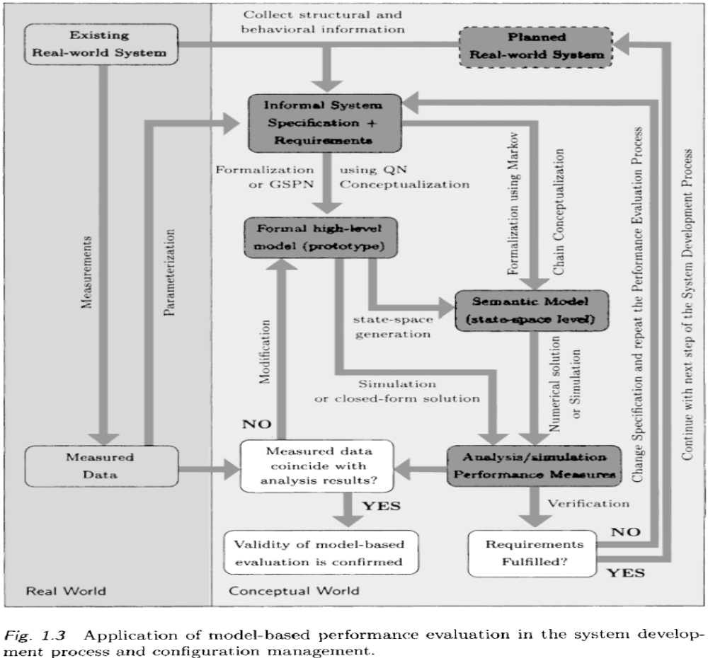
1.2.4 Summary (4)

Slide 62
1.2.4 Summary (5)
In case of a Markov chain conceptualization, a formal representation on the state-space level is created.
In case of a queuing network or stochastic Petri net conceptualization, a formal high-level model is derived.
The formal model represents the system as well as the interaction with its environment on a conceptual level and, as a result, the model abstracts from all details which are considered to be irrelevant for the evaluation.

Slide 63
1.2.4 Summary (5)
In the scenario of an existing real-world system, a conceptual validation of the correctness of the high-level model can be accomplished in an iterative process of step-wise refinement [Wirt71, Morr871, which is not represented in Fig. 1.3.
Conceptual validation can be further refined [NaFi67] into “face validation,” where the involved domain experts try to reach consensus on the appropriateness of the model on the basis of dialogs, and into the “validation of the model assumptions,” where implicit or explicit assumptions are cross-checked.

Slide 64
1.2.4 Summary (6)
Some of the crucial properties of the model are checked by answering the following questions [HMT9l] :
Is the model logically correct, complete, or overly detailed?
Are the distributional assumptions justified? How sensitive are the results to simplifications in the distributional assumptions?
Are other stochastic properties, such as independence assumptions, valid?
Is the model represented on the appropriate level? Are those features included that are most significant for the application context?

Slide 65
1.2.4 Summary (7)
The deduction of performance measures can be carried out either by the application of closed-form solution methods/simulation based on a high-level description or by numerical analysis/simulation of a Markov chain.
The link between high-level model and semantic model represents the state-space generation activity which is in most cases performed automatically inside an appropriate performance analysis tool. The use of tools for an automated generation of state-space representations has the advantage of generating a semantic model that can be regarded as a lower-level implementation reflecting all system properties as described in the high-level model.

Slide 66
1.2.4 Summary (8)
After performance measures have been derived, they can be validated against data collected through measurements, if an existing system is available.
The validation results are used for modification of the high-level model.
In the system development scenario the calculated performance measures are used to verify whether the final product meets its performance related requirements.
If the answer from the verification step is “NO,” the formal system description has to be redesigned and the performance evaluation process starts anew.

Slide 67
1.2.4 Summary (9)
If the answer of the verification step is “YES,” the system development process can move on to the subsequent detailed design and implementation phases.
In the system configuration and capacity planning scenarios there is a strong relation between measurements and modeling.
Measurement data are to be used for model validation. Furthermore, model parameterization relies heavily on input from measurement results. Model parameters are frequently derived from measurements of earlier studies on similar systems also in the system development scenario.
Conversely, measurement studies can often be better planned and executed if they are complemented and guided by a model-based evaluation.

Slide 68
1.3 Basics of Probability and Statistics
1.3.1 Random Variables
1.3.2 Multiple Random Variables
1.3.3 Transforms
1.3.4 Parameters Estimation
1.3.5 Order Statistics
1.3.6 Distribution of Sums

Slide 69
1.3.1 Random Variables (1)
A random variable is a function that reflects the result of a random experiment. The result of the experiment “toss a single die” can be described by a random variable that can assume the values one through six.
The number of requests that arrive at an airline reservation system in one hour or
The number of jobs that arrive at a computer system are also examples of
The time interval between the arrivals of two consecutive jobs at a computer system, or
The throughput in such a system.
The latter two examples can assume continuous values, whereas the first two only assume discrete values.

Slide 70
1.3.1.1 Discrete Random Variables (1)
A random variable that can only assume discrete values is called a discrete random variable, where the discrete values are often non-negative integers.
The random variable is described by the possible values that it can assume and by the probabilities for each of these values.
The set of these probabilities is called the probability mass function (pmf) of this random variable.

Slide 71
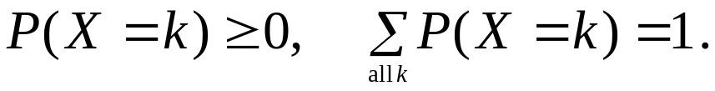
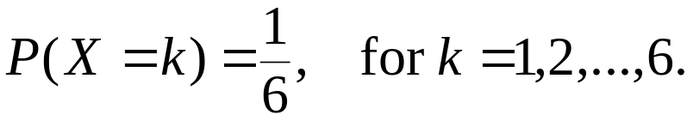
1.3.1.1 Discrete Random Variables (2)
Thus, if the possible values of a random variable X are the non-negative integers, then the pmf is given by the probabilities:
the probability that the random variable X assumes the value k.
The following is required :
For example, the following pmf results from the experiment “toss a single die” :

Slide 72
1.3.1.1 Discrete Random Variables (3)
The following are other examples of discrete random variables :
Bernoulli random variable: Consider a random experiment that has two possible outcomes, such as tossing a coin (k = 0,l). The pmf of the random variable X is given by

Slide 73
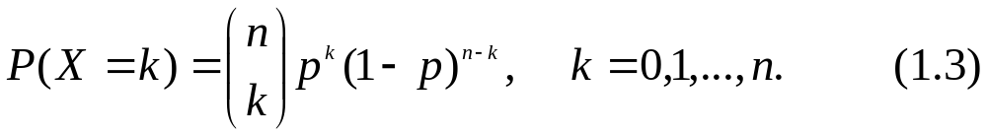
1.3.1.1 Discrete Random Variables (4)
Binomial random variable: The experiment with two possible outcomes is carried out n times where successive trials are independent. The random variable X is now the number of times the outcome 1 occurs. The pmf of X is given by
Geometric random variable: The experiment with two possible outcomes is carried out several times, where the random variable X now represents the number of trials it t,akes for the outcome 1 to occur (the current trial included). The pmf of X is given by

Slide 74
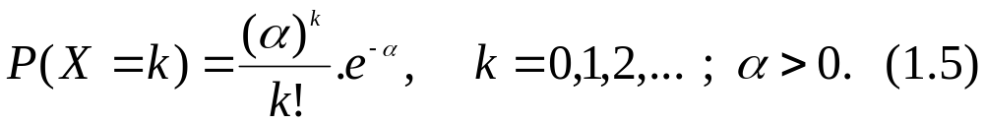
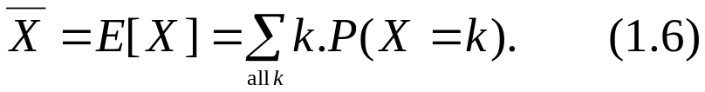
1.3.1.1 Discrete Random Variables (5)
Poisson random variable: The probability of having k events (Poisson pmf) is given by
The Poisson and geometric random variables are very important to our topic; we will encounter them very often.
Several important parameters can be derived from a pmf of a discrete random variable:
Mean value or expected value:

Slide 75

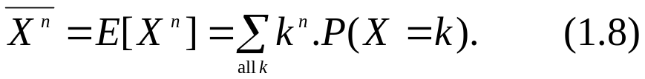
1.3.1.1 Discrete Random Variables (6)
The function of a random variable is another random variable with the expected value of
nth moments:
that is, the nth moment is the expected value of the nth power of X.
The first moment of X is simply the mean of X.

Slide 76

1.3.1.1 Discrete Random Variables (7)
nth central moment:
The 72th central moment is the expected value of the nth power of the difference between X and its mean. The first central moment is equal to zero.
The second central moment is called the variance of X:
where is called the standard deviation.

Slide 77
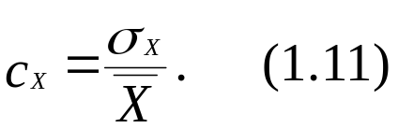



1.3.1.1 Discrete Random Variables (8)
The coefficient of variation is the normalized standard deviation:
The second moment can be easily obtained from the coefficient of variation:
Information on the average deviation of a random variable from its expected value is provided by
If then the random variable assumes a fixed value with probability one.

Slide 78
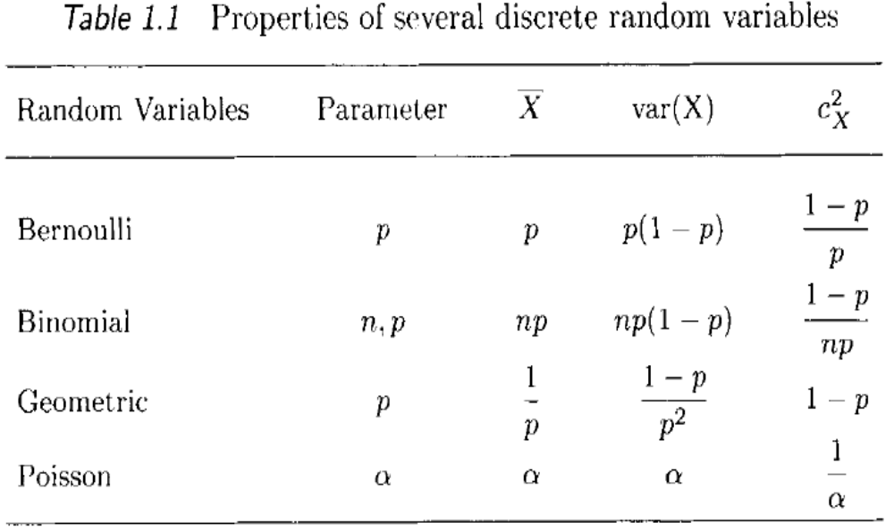
1.3.1.1 Discrete Random Variables (9)

Slide 79


1.3.1.2 Continuous Random Variables (1)
A random variable X that can assume all values in the interval , where , is called a continuous random variable. It is described by its distribution function (also called CDF or cumulative distribution function):
which specifies the probability that the random variable X takes values less than or equal to x, for every x.
From Eq. (1.13) we get for x < y:

Slide 80

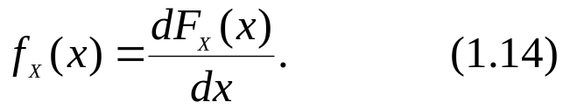
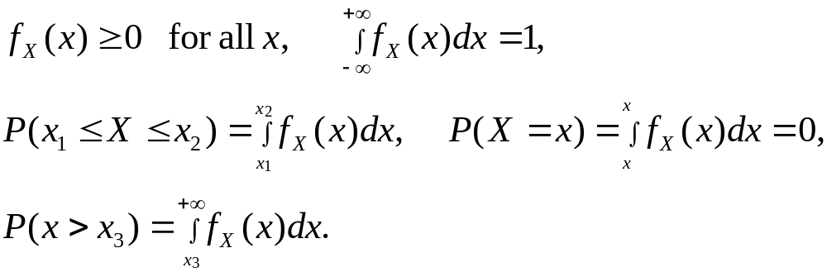
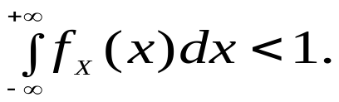
1.3.1.2 Continuous Random Variables (2)
The probability density function (pdf) can be used instead of the distribution function, provided the latter is differentiable:
Some properties of the pdf are:
Note that for so-called defective random variables [STP96] we have:

Slide 81
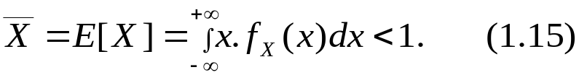
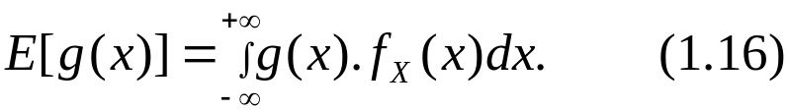
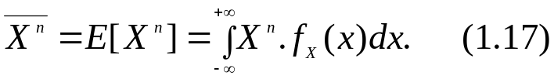
1.3.1.2 Continuous Random Variables (3)
The density function of a continuous random variable is analogous to the pmf of a discrete random variable.
The formulae for the mean value and moments of continuous random variables can be derived from the formulae for discrete random variables by substituting the pmf by the pdf and the summation by an integral:
Mean value or expected value:
and
nth moment:

Slide 82

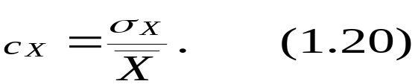
1.3.1.2 Continuous Random Variables (4)
nth central moment:
Variance:
with as the standard deviation.
Coefficient of variation:

Slide 83
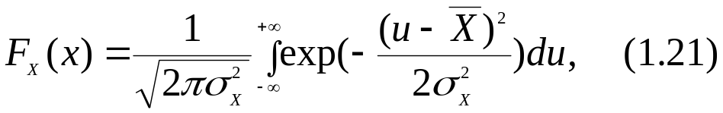
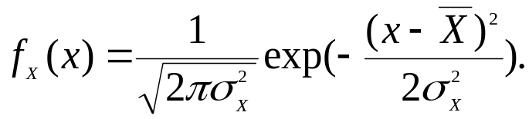
1.3.1.2 Continuous Random Variables (5)
A very well-known and important continuous distribution function is the normal distribution. The CDF of a normally distributed random variable X is given by
and the pdf by

Slide 84

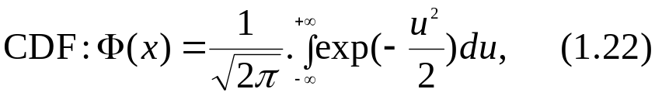
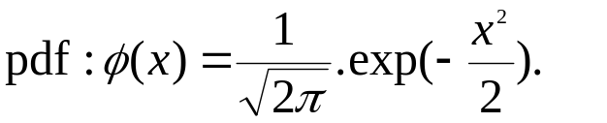
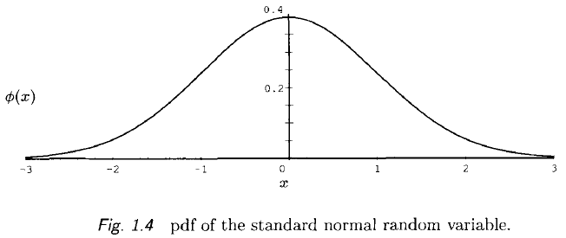
1.3.1.2 Continuous Random Variables (6)
The standard normal distribution is defined by setting
A plot of the preceding pdf is shown in Fig. 1.4.

Slide 85
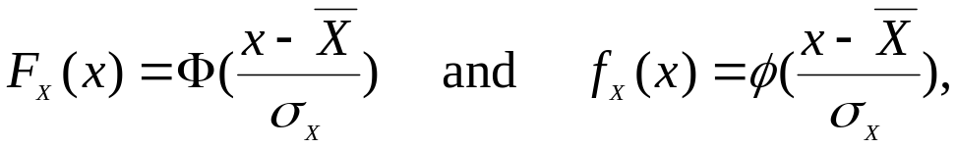
1.3.1.2 Continuous Random Variables (7)
For an arbitrary normal distribution we have
respectively.
Other important continuous random variables are described as follows.

Slide 86
1.3.1.2 Continuous Random Variables (8)
Exponential Distribution:
The exponential distribution is the most important and also the easiest to use distribution in queuing theory.
Interarrival times and service times can often be represented exactly or approximately using the exponential distribution.

Slide 87
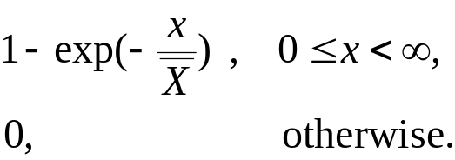

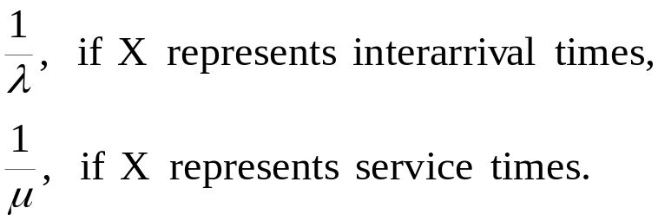


1.3.1.2 Continuous Random Variables (9)
Exponential Distribution(cont’d):
The CDF of an exponentially distributed random variable X is given by Eq. (1.23):
Here denote the parameter of the random variable.
(1.23)

Slide 88

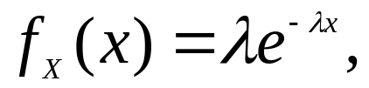
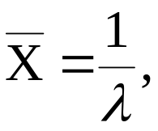
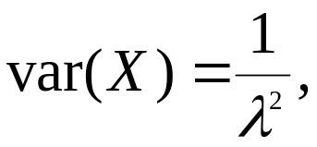

1.3.1.2 Continuous Random Variables (10)
Exponential Distribution(cont’d):
In addition, for an exponentially distributed random variable with parameter the following relations hold:
Thus, the exponential distribution is completely determined by its mean value.
pdf:
mean:
variance:
coefficient of variation:

Slide 89
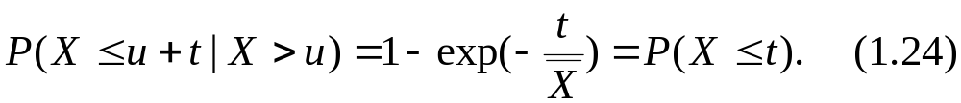
1.3.1.2 Continuous Random Variables (11)
Exponential Distribution(cont’d):
The importance of the exponential distribution is based on the fact that it is the only continuous distribution that possesses the memoryless property:

Slide 90

1.3.1.2 Continuous Random Variables (12)
Exponential Distribution(cont’d):
As an example for an application of Eq. (1.24), consider a bus stop with the following schedule:
Buses arrive with exponentially distributed interarrival times and identical mean .
Now if you have already been waiting in vain for u units of time for the bus to come, the probability of a bus arrival within the next t units of time is the same as if you had just shown up at the bus stop, that is,
you can forget about the past or about the time already spent waiting.

Slide 91


1.3.1.2 Continuous Random Variables (13)
Exponential Distribution(cont’d):
Another important property of the exponential distribution is its relation to the discrete Poisson random variable.
If the interarrival times are exponentially distributed and successive interarrival times are independent with identical mean , then the random variable that represents the number of buses that arrive in a fixed interval of time has a Poisson distribution with parameter .

Slide 92




1.3.1.2 Continuous Random Variables (14)
Exponential Distribution(cont’d):
Two additional properties of the exponential distribution can be derived from the Poisson property:
If we merge n Poisson processes with distributions for the interarrival times ,
, into one single process, then the result is a Poisson process for which the interarrival times have the distribution with (see Fig. 1.5).

Slide 93



1.3.1.2 Continuous Random Variables (15)
Exponential Distribution(cont’d):
If a Poisson process with interarrival time distribution is split into n processes so that the probability that the arriving job is assigned to the ith process is then the ith subprocess has an interarrival time distribution of , i.e., n Poisson processes have been created, as shown in Fig 1.6.

Slide 94
1.3.1.2 Continuous Random Variables (16)
Exponential Distribution(cont’d):
The exponential distribution has many useful properties with analytic tractability, but is not always a good approximation to the observed distribution.
For example, the coefficient of variation of the service time of a processor is often greater than one, and for a peripheral device it is usually less than one.
This observed behavior leads directly to the need to consider the following other distributions.

Slide 95

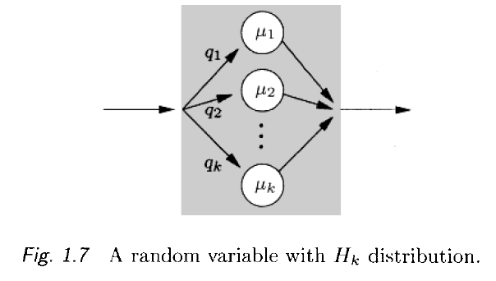
1.3.1.2 Continuous Random Variables (17)
Hyperexponential Distribution, :
This distribution can be used to approximate empirical distributions with a coefficient of variation larger than one. Here k is the number of phases.
Figure 1.7 shows a model with hyperexponentially distributed time.

Slide 96



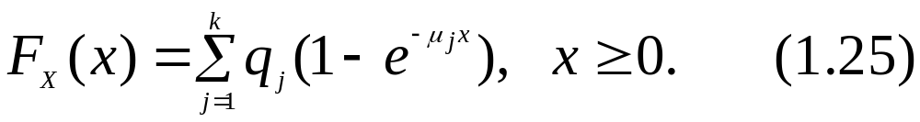
1.3.1.2 Continuous Random Variables (18)
Hyperexponential Distribution, (cont’d):
The model is obtained by arranging k phases with exponentially distributed times and rates
in parallel. The probability that the time span is given by the jth phase is , where . However, only one phase can be occupied at any time. The resulting CDF is given by

Slide 97
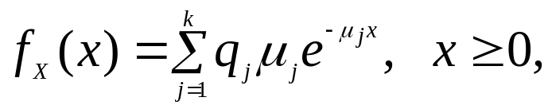
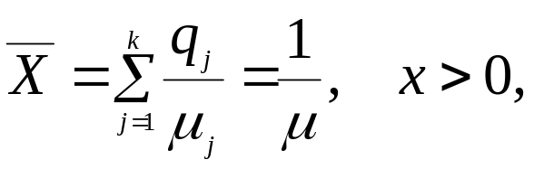
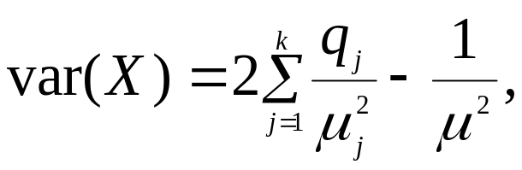
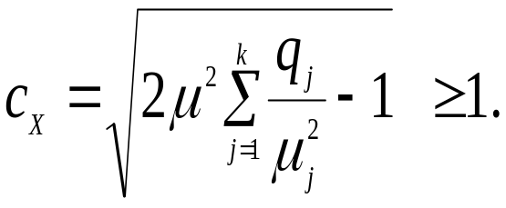
1.3.1.2 Continuous Random Variables (19)
Hyperexponential Distribution, (cont’d):
In addition, the following relations hold:
pdf:
mean:
variance:
coefficient of variation:

Slide 98




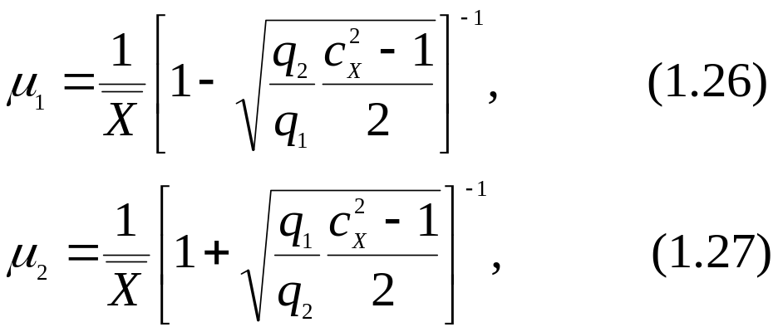


1.3.1.2 Continuous Random Variables (20)
Hyperexponential Distribution, (cont’d):
For example, the parameters of an distribution can be estimated to approximate an unknown distribution with given mean and sample coefficient of variation as follows:
The parameters and can be assigned any values that satisfy the restrictions

Slide 99



1.3.1.2 Continuous Random Variables (21)
Erlang-k Distribution, :
Empirical distributions with a coefficient of variation less than one can be approximated using the Erlang-k distribution. Here k is the number of exponential phases in series.
Figure 1.8 shows a model of a time duration that has an distribution.
It contains k identical phases connected in series, each with exponentially distributed time. The mean duration of each phase is , where
denotes the mean of the whole time span.

Slide 100
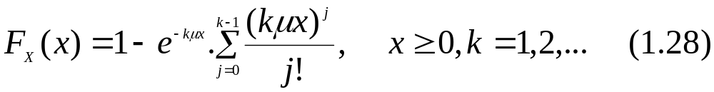
1.3.1.2 Continuous Random Variables (22)
Erlang-k Distribution, (cont’d):
If the interarrival times of some arrival process like our bus stops are identical exponentially distributed, it follows that the time between the first arrival and the (k + 1)th arrival is Erlang-k distributed.
The CDF is given by

Slide 101
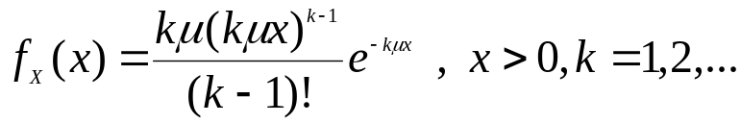
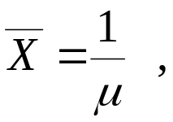
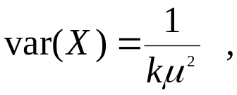
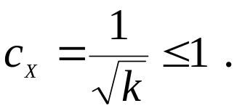
1.3.1.2 Continuous Random Variables (23)
Erlang-k Distribution, (cont’d):
Further characteristic measures are:
pdf:
mean:
variance:
coefficient of variation:

Slide 102


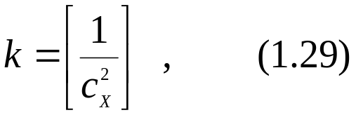
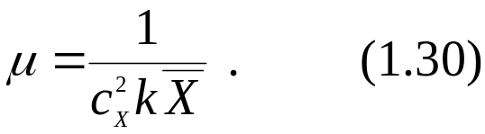
1.3.1.2 Continuous Random Variables (24)
Erlang-k Distribution, (cont’d):
If the sample mean and the sample coefficient of variation are given, then the parameters k and p of the corresponding Erlang distribution are estimated by
and

Slide 103


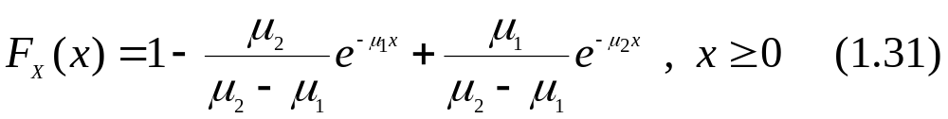
1.3.1.2 Continuous Random Variables (25)
Hypoexponential Distribution :
The hypoexponential distribution arises when the individual phases of the ; distribution are allowed to have assigned different rates.
Thus, the Erlang distribution is a special case of the hypoexponential distribution.
For a hypoexponential distributed random variable X with two phases and the rates
, we get the CDF as

Slide 104
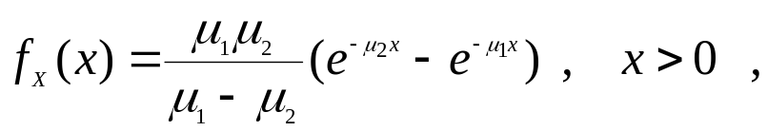
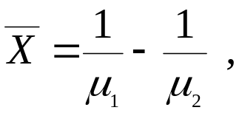
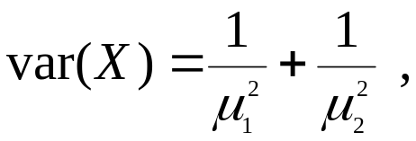
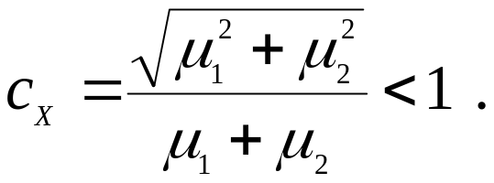
1.3.1.2 Continuous Random Variables (26)
Hypoexponential Distribution (cont’d):
Furthermore, the following relations hold:
pdf:
mean:
variance:
coefficient of variation:

Slide 105

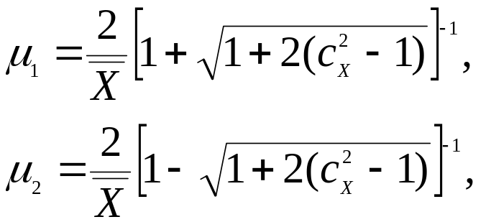

1.3.1.2 Continuous Random Variables (27)
Hypoexponential Distribution (cont’d):
The values of the parameters of the hypoexponential CDF can be estimated given the sample mean and sample coefficient of variation by
with .

Slide 106

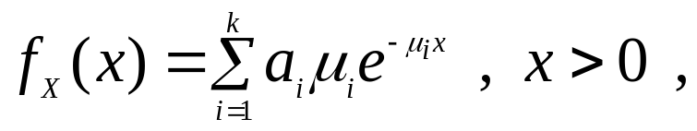



1.3.1.2 Continuous Random Variables (28)
Hypoexponential Distribution (cont’d):
For a hypoexponential distribution with k phases and the phase rates we get[Bega93]
pdf:
with
mean:
coefficient of variation:

Slide 107




1.3.1.2 Continuous Random Variables (29)
Gamma Distribution :
Another generalization of the Erlang-k distribution for arbitrary coefficient of variation is the gamma distribution.
The distribution function is given by
If is a positive integer, then
(1.32)
with

Slide 108




1.3.1.2 Continuous Random Variables (30)
Gamma Distribution (cont’d):
Thus, the Erlang-k distribution can be considered as a special case of the gamma distribution:
pdf:
mean:
variance:
coefficient of variation:

Slide 109





1.3.1.2 Continuous Random Variables (31)
Gamma Distribution (cont’d):
It can be seen that the parameters and of the gamma distribution can easily be estimated from and :

Slide 110
1.3.1.2 Continuous Random Variables (32)
Generalized Erlang Distribution :
Rather complex distributions can be generated by combining hyperexponential and Erlang-k distributions; these are known as generalized Erlang distributions.

Slide 111



1.3.1.2 Continuous Random Variables (33)
Generalized Erlang Distribution (cont’d):
An example is shown in Fig. 1.9 where n parallel levels are depicted and each level j contains a series of phases connected, each with exponentially distributed time and rate . Each level j is selected with probability j.

Slide 112

1.3.1.2 Continuous Random Variables (34)
Generalized Erlang Distribution (cont’d):
The pdf is given by
Another type of generalized Erlang distribution can be obtained by lifting the restriction that all the phases within the same level have the same rate, or,
alternatively, if there are nonzero exit probabilities assigned such that remaining phases can be skipped. These generalizations lead to very complicated equations that are not further described here.

Slide 113

1.3.1.2 Continuous Random Variables (35)
Cox Distribution, (Branching Erlang Distribution) :
In [Cox55] the principle of the combination of exponential distributions is generalized to such an extent that any distribution that possesses a rational Laplace transform can be represented by a sequence of exponential phases with possibly complex probabilities and complex rates.

Slide 114


1.3.1.2 Continuous Random Variables (36)
Cox Distribution, (Branching Erlang Distribution) (cont’d):
Figure 1.10 shows a model of a Cox distribution with k exponential phases.
The model consists of k phases in series with exponentially distributed times and rates
.

Slide 115


1.3.1.2 Continuous Random Variables (37)
Cox Distribution, (Branching Erlang Distribution) (cont’d):
After phase j , another phase j + 1 follows with probability and with probability the total time span is completed.
As described in [SaCh81], there are two cases that must be distinguished when using the sample mean value and the sample coefficient of variation to estimate the parameters of the Cox distribution:

Slide 116




1.3.1.2 Continuous Random Variables (38)
Cox Distribution, (Branching Erlang Distribution) (cont’d):
Case 1:
To approximate a distribution with we suggest using a special Cox distribution with (see Fig. 1.11)

Slide 117



1.3.1.2 Continuous Random Variables (39)
Cox Distribution, (Branching Erlang Distribution) (cont’d):
From the probabilistic definitions, we obtain
mean:
Variance:
Squared coeff.
of variation:

Slide 118





1.3.1.2 Continuous Random Variables (40)
Cox Distribution, (Branching Erlang Distribution) (cont’d):
In order to minimize the number of stages, we choose k such that
Then we obtain the parameters and from the preceding equations:

Slide 119



1.3.1.2 Continuous Random Variables (41)
Cox Distribution, (Branching Erlang Distribution) (cont’d):
Case 1:
For the case , we use a Cox-2 model (see Fig. 1.12).

Slide 120



1.3.1.2 Continuous Random Variables (42)
Cox Distribution, (Branching Erlang Distribution) (cont’d):
From classical formulae, we obtain
mean:
Variance:
Squared coeff.
of variation:

Slide 121



1.3.1.2 Continuous Random Variables (43)
Cox Distribution, (Branching Erlang Distribution) (cont’d):
We have two equations for the three parameters and therefore obtain an infinite number of solutions. To obtain simple equations we choose
and obtain from the preceding equations

Slide 122

1.3.1.2 Continuous Random Variables (44)
Weibull Distribution :
The Weibull distribution is at present the most widely used failure distribution. Its CDF is given by
From this definition, the following relations can be derived:
pdf:
mean:

Slide 123








1.3.1.2 Continuous Random Variables (45)
Weibull Distribution (cont’d):
with the shape parameter , which determines the type of the failure behavior( means infant mortality and means wear out) and the so-called scale parameter
is often referred to as the characteristic lifetime of the Weibull distribution, as, independent of the value of
Squared coeff.
of variation:

Slide 124





1.3.1.2 Continuous Random Variables (46)
Pareto Distribution :
The Pareto distribution acquired importance due to the nature of Internet traffic. Its CDF is given by
Additionally, the following relations hold:
(1.40)
pdf:
mean:

Slide 125




1.3.1.2 Continuous Random Variables (47)
Pareto Distribution (cont’d):
In the case of the Pareto distribution, is called the shape parameter and k is referred to as scale parameter.
Note that Pareto distribution from Eq. (1.40) distribution can exhibit infinite mean and infinite variance depending on the value of the shape parameter .
variance:
Squared coeff.
of variation:

Slide 126



1.3.1.2 Continuous Random Variables (48)
Pareto Distribution (cont’d):
One typical property of the Pareto distribution is that it is heavy-tailed, as also the Weibull distribution with a shape parameter smaller than one. A distribution is said to be heavy-tailed (or long-tailed) if
for any i.e., if its complementary distribution function, which is defined as
decays more slowly than exponentially.

Slide 127
1.3.1.2 Continuous Random Variables (49)
Pareto Distribution (cont’d): ***
Heavy-tailed distributions have gained attention recently as being useful for characterizing many types of Internet traffic. This traffic was considered to have a Poisson-like nature in the past. In the meantime it has been shown [LTWW94] that this kind of traffic is self-similar. Informally speaking, self-similarity means that the shape of the traffic is invariant with respect to thetime-scale; for example, the histogram of packets per time unit has the same shape if a histogram is built over 1000 seconds or 10 seconds if the timestep for building the classes in the histogram is changed in the same scale.

Slide 128
1.3.1.2 Continuous Random Variables (50)
Pareto Distribution (cont’d): ***
In contrast to this, if a Poisson process is assumed, peaks are flattened out when the time unit is enlarged. This implies, that a long-range dependence may play an important role when Internet traffic is analyzed. However, there are some recent papers [DownOl] that question the self-similarity in specific situations.
Heavy-tailed distributions can be used to model self-similar processes and the Pareto distribution is one of the most common heavy-tailed distributions. For details on self-similarity the reader is referred to ILTWW941 and for more information about the effect of heavy-tails to [BBQHOS].

Slide 129






1.3.1.2 Continuous Random Variables (51)
Lognormal Distribution :
The lognormal distribution is given by
Additionally, the following relations hold:
where the shape parameter is positive and the
scale parameter may assume any real value.
pdf:
mean:
Squared coeff.
of variation:

Slide 130




1.3.1.2 Continuous Random Variables (52)
Lognormal Distribution (cont’d):
As the Pareto distribution, the lognormal distribution is also a heavy-tailed distribution.
The parameters and can easily be calculated from and :
The importance of this distribution arises from the fact that the product of n mutually independent random variables has a lognormal distribution in the limit .

Slide 131

1.3.1.2 Continuous Random Variables (53)

Slide 132

1.3.1.2 Continuous Random Variables (54)

Slide 133

1.3.1.2 Continuous Random Variables (55)
Table 1.3 (cont’d)

Slide 134


1.3.2 Multiple Random Variables (1)
In some cases, the result of one random experiment determines the values of several random variables, where these values may also affect each other.
The joint probability mass function of the discrete random variables is given by
and represents the probability that
.

Slide 135






1.3.2 Multiple Random Variables (2)
In the continuous case, the joint distribution function:
represents the probability that
, where is the n-dimensional random variable and
.
A simple example of an experiment with multiple discrete random variables is tossing a pair of dice. The following random variables might be determined:
number that shows on the first die,
number that shows on the second die,
, sum of the numbers of both dice.

Slide 136


1.3.2.1 Independence (1)
The random variables are called (statistically) independent if,
for the continuous case:
or the discrete case:
Otherwise, they are (statistically) dependent.

Slide 137




1.3.2.1 Independence (2)
In the preceding example of tossing a pair of dice, the random variables are independent, whereas are dependent on each other.
For example:
since there are 36 different possible results altogether that are all equally probable.
Because the following is also valid:
is true, and therefore are independent.

Slide 138




1.3.2.1 Independence (3)
On the other hand, if we observe the dependent variables , then
since are independent.
Having and
results in ,
which shows the dependency of the random variables :

Slide 139





1.3.2.2 Conditional Probability (1)
A conditional probability:
is the probability for under the conditions
Then we get
For continuous random variables we have

Slide 140





1.3.2.2 Conditional Probability (2)
We demonstrate this also with the preceding example of tossing a pair of dice.
The probability that under the condition that is given
For example, with j = 4 and i = 2:
If we now observe both random variables
, we will see that because of the independence of ,

Slide 141



1.3.2.3 Important Relations (1)
The following relations concerning multiple random variables will be used frequently in the text:
The expected value of a sum of random variables is equal to the sum of the expected values of these random variables. If are arbitrary constants and are (not necessarily independent) random variables, then

Slide 142


1.3.2.3 Important Relations (2)
If the random variables are stochastically independent, then the expected value of the product of the random variables is equal to the product of the expected values of the random variables:
The covariance of two random variables X and Y is a way of measuring the dependency between X and Y. It is defined by

Slide 143



1.3.2.3 Important Relations (3)
If X = Y, then the covariance is equal to the variance:
If X and Y are statistically independent, then Eq. (1.51) gives us
and Eq. (1.52) gives us
In this case, X and Y are said to be uncorrelated.

Slide 144


1.3.2.3 Important Relations (4)
The correlation coefficient is the covariance normalized to the product of standard deviations:
Therefore, if X = Y, then

Slide 145


1.3.2.3 Important Relations (5)
The variance of a sum of random variables can be expressed using the covariance:
For independent (uncorrelated) random variables we get

Slide 146










1.3.2.4 The Central Limit Theorem
Let be independent, identically distributed random variables with an expected value of and a variance of Then their arithmetic mean is defined by
We have and Regardless of the distribution of the random variable approaches, with increasing n, a normal distribution with a mean of and a variance of
:

Slide 147
1.3.3 Transforms
Determining the mean values, variance, or moments of random variables is often rather tedious. However, these difficulties can sometimes be avoided by using transforms, since the pmf of a discrete or the density function of a continuous random variable are uniquely determined by their z- or Laplace transform, respectively. Thus, if two random variables have the same transform, they also have the same distribution function and vice versa. In many cases, the parameters of a random variable are, therefore, more easily computed from the transform.

Slide 148



1.3.3.1 z-Transform (1)
Let X be a discrete random variable with the probability mass function then the z-transform of X is defined by
The function is also called the probability generating function.

Slide 149
1.3.3.1 z-Transform (2)
Table 1.4 specifies the probability generating functions of some important discrete random variables.

Slide 150




1.3.3.1 z-Transform (3)
If the z-transform of a random variable is given, then the probabilities can be calculated immediately:
And for the moments

Slide 151




1.3.3.1 z-Transform (4)
with
The generating function of a sum of independent random variables is the product of the generating functions of each random variable, so for we get

Slide 152




1.3.3.1 Laplace Transform (1)
The Laplace transform plays a similar role for non-negative continuous random variables as the z-transform does for discrete random variables.
If X is a continuous random variable with the density function then the Laplace transform (LT) of the density function (pdf) of X is defined by
where s is a complex parameter.
is also called the Laplace-Stieltjes transform (LST) of the distribution function (CDF) and can also be written as

Slide 153



1.3.3.1 Laplace Transform (2)
LST of a random variable X will also be denoted by
The moments can again be determined by differentiation:
Analogous to the z-transform, the Laplace transform of a sum of independent random variables is the product of the Laplace transform of these random variables:

Slide 154

1.3.3.1 Laplace Transform (3)
The Laplace transforms of several pdfs of well-known continuous random variables as well as their moments are given in Table 1.5.

Slide 155


1.3.4 Parameter Estimation (1)
Probability calculations discussed in this book require that the parameters of all the relevant distributions are known in advance.
For practical use, these parameters have to be estimated from measured data. In this subsection, we briefly discuss statistical methods of parameter estimation. For further details see [TrivOl].
Definition 1.6 Let the set of random variables
be given. This set is said to constitute a random sample of size n from a population with associated distribution function Assume that the random variables are mutually independent and identically distributed with distribution function (CDF)

Slide 156





1.3.4 Parameter Estimation (2)
We are interested in estimating the value of some parameter (e.g., the mean or the variance of the distribution or the parameters of the distribution themselves) of the population based on the random samples.
Definition 1.7 A function is called an estimator of the parameter , and an observed value is known as an estimate of . An estimator is considered unbiased, if

Slide 157





1.3.4 Parameter Estimation (3)
It can be shown that the sample mean , defined as
is an unbiased estimator of the population mean
, and that the sample variance , defined as
is an unbiased estimator of the population variance .

Slide 158


1.3.4 Parameter Estimation (4)
Definition 1.8 An estimator of a parameter is said to be consistent if converges in probability to (so-called stochastic convergence); that is

Slide 159

1.3.4.1 Method of Moments (1)
The kth sample moment of a random variable X is defined as
To estimate one or more parameters of the distribution of X, using the method of moments, we equate the first few population moments with their corresponding sample moments to obtain as many equations as the number of unknown parameters. These equations can then be solved to obtain the required estimates. The method yields estimators that are consistent, but they may be biased.

Slide 160








1.3.4.1 Method of Moments (2)
As an example, suppose the time to failure of a computer system has a gamma distributed pdf :
with parameters and . We know that the
first two population moments are given by
Then the estimates and can be obtained by solving
Hence

Slide 161
1.3.4.1 Method of Moments (3)
One of the drawbacks of the method of moments is that the solution of the emerging equations may become problematic when there are more than two parameters to be estimated as there may exist no exact solution and therefore optimization methods or least-squares fits would have to be employed.
A preferred method of estimation is based on linear regression or maximum likelihood.

Slide 162
1.3.4.2 Linear Regression (1)
Linear regression is one of the most common statistical inference procedures :
simplicity
computational efficiency
The basic idea of linear regression is to transform the CDF of the distribution to be fitted into a linear form y = a . z + b.
Then, a least-squares fit through the sample data which defines a straight line is sought for.
Finally, the parameters of the distribution itself are computed from the parameters of the straight line by a back-transformation.

Slide 163






1.3.4.2 Linear Regression (2)
As an example consider the estimation of the shape parameter and the scale parameter of a Weibull distribution from a given sample. The CDF is given as
Taking the natural logarithm twice we get
The used for the least-squares fit are the values in the given sample in ascending order. For the , the empirical CDF needs to be obtained from the measured data.

Slide 164


1.3.4.2 Linear Regression (3)
Usually median ranks, which can be easily computed by the approximation
are used [Aber94], when the sample size n is small.
The i in Eq. (1.73) denotes the index of the failure in the ordered sample of failures. From the least-squares solution the Weibull parameters can then be computed by the back-transformation .

Slide 165
1.3.4.2 Linear Regression (4)
One of the reasons for the popularity of linear regression may be that one does not necessarily need a computer to perform the estimation as there is also a graphical solution, the so-called “probability-paper.”
In the case of the Weibull distribution this is a coordinate system with logarithmic z-axis and double-logarithmic y-axis, in which the sample points are plotted.
By eye-balling a straight line through the sample points one can determine the distribution parameters from the slope and the y-axis intercept.

Slide 166
1.3.4.2 Linear Regression (5)
The only limitation of the linear regression is that a transformation into linear form has to exist which, for example, is not the case for a weighted sum of exponential distributions.

Slide 167



1.3.4.2 Maximum-Likelihood Estimation (1)
The principle of this method is to select as an estimate of the value for which the observed sample is most likely to occur.
We define the likelihood function as the product of the marginal densities:
where is the vector of parameters to be estimated.
As shown in [ReWa84] the likelihood function is itself a density function. Therefore, it is a measure for the probability that the observed sample comes from the distribution the parameters of which have to be estimated. This probability corresponds to the estimate that maximizes the likelihood function.

Slide 168


1.3.4.2 Maximum-Likelihood Estimation (2)
Under some regularity conditions, the maximum-likelihood estimate of is the simultaneous solution of the set of equations:
As an example: assume an arrival process where the interarrival time, X , is exponentially distributed with arrival rate .
To estimate the arrival rate from a random sample of n interarrival times, we define:

Slide 169

1.3.4.2 Maximum-Likelihood Estimation (3)
from which we get the maximum-likelihood estimator of the arrival rate that is equal to the reciprocal of the sample mean .

Slide 170
1.3.4.2 Maximum-Likelihood Estimation (3) ***
In the cases where the solution of the system of equations (1.75) is too complex, a nonlinear optimization algorithm can be used that maximizes the
likelihood function from Eq. (1.74). This Optimization algorithm needs to incorporate any constraints on the parameters to be estimated (for example, for the exponential distribution there is the constraint > 0). Furthermore, it is not guaranteed that the likelihood function is unimodal. It may have several local maxima in addition to a global maximum. Therefore, a global
optimization algorithm such as a genetic algorithm [Gold891 or interval arithmetic [LiiLlOO] may be in order. From a practical point of view, however, such
approaches may imply very long calculation times. As an alternative it has become common to use a local optimization algorithm and to run it repeatedly
with different initial values. Such an approach is particularly justifiable if a rough estimate of at least the order of magnitude of the parameter values is known in advance.

Slide 171



1.3.4.2 Maximum-Likelihood Estimation (3) ***
Since the likelihood function is defined as a product of densities, numerical difficulties may arise. Assume for example a sample of 100 elements with density values in an order of magnitude of each. This leads to a likelihood function in an order of magnitude of about which is hardly insight any computing precision range. This difficulty is alleviated by using the logarithm of the likelihood function and which is given as
As the logarithm is a monotone function, the position of the maximum is not changed by this transformation.

Slide 172
1.3.4.4 Confidence Intervals (3)
So far we have concentrated on obtaining the point estimates of a desired parameter.
However, it is very rare in practice for the point estimate to actually coincide with the exact value of the parameter under consideration.
In this subsection, we introduce into the technique of computing an interval estimate.
Such an interval, called the confidence interval, is constructed in a way that we have a certain confidence that this interval contains_the true value of the unknown parameter .

Slide 173





1.3.4.4 Confidence Intervals (3)
In other words, if the estimator satisfies the condition
then the interval is a percent confidence interval for the parameter
.
Here is called the confidence coefficient (the probability that the confidence interval contains ).

Slide 174
Under construction !

Slide 175
1.3.4.4 Confidence Intervals (3)

Slide 176






Parameter Estimation

Slide 177

Parameter Estimation

Slide 178
Parameter Estimation
1.3.5 Order Statistics

